Slide 1
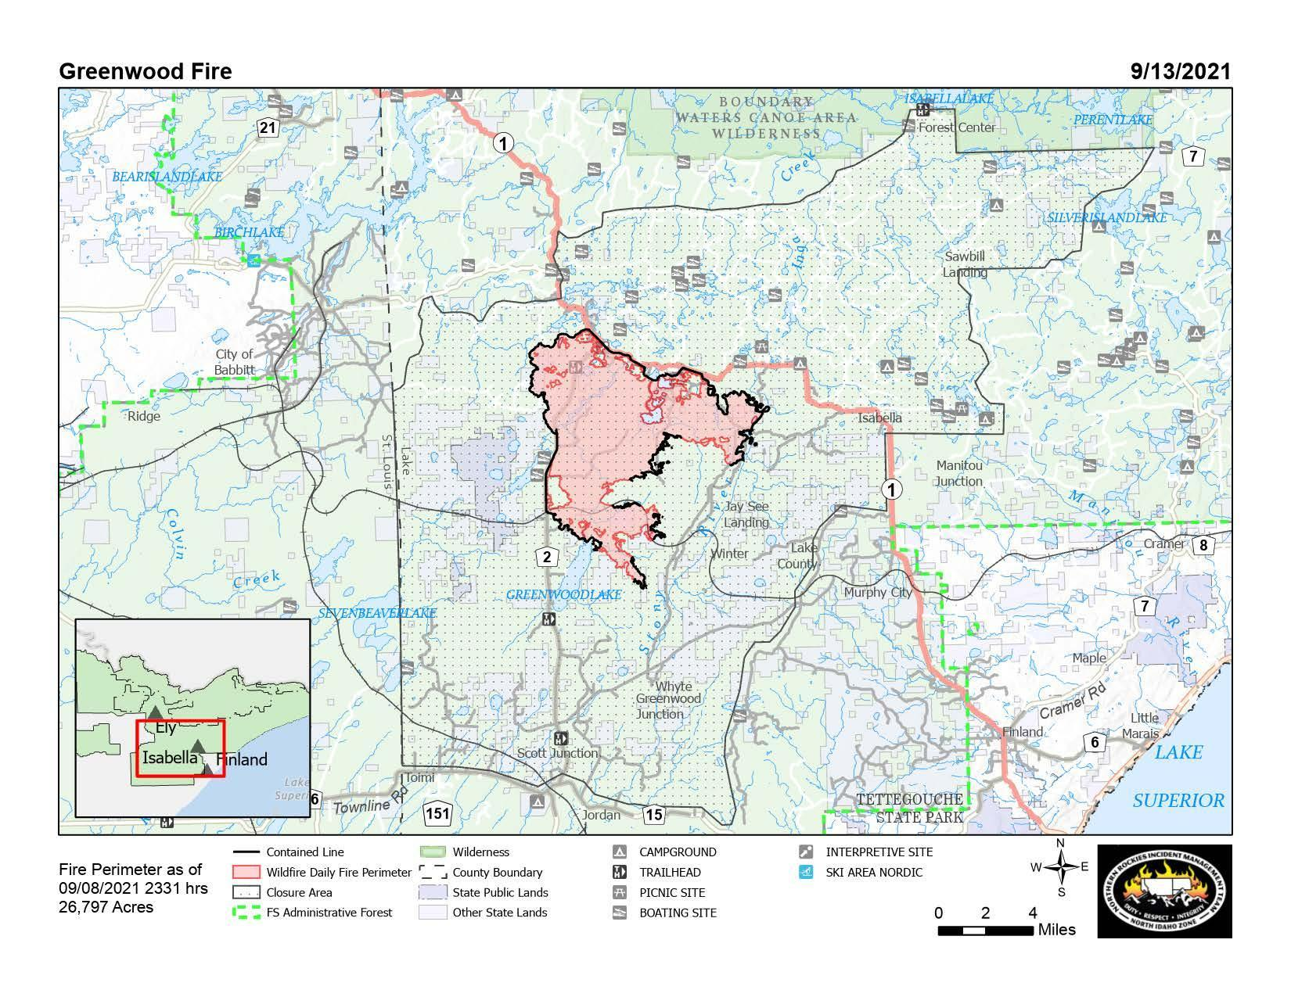
https://inciweb.nwcg.gov/incident/map/7805/0/125373

Slide 2
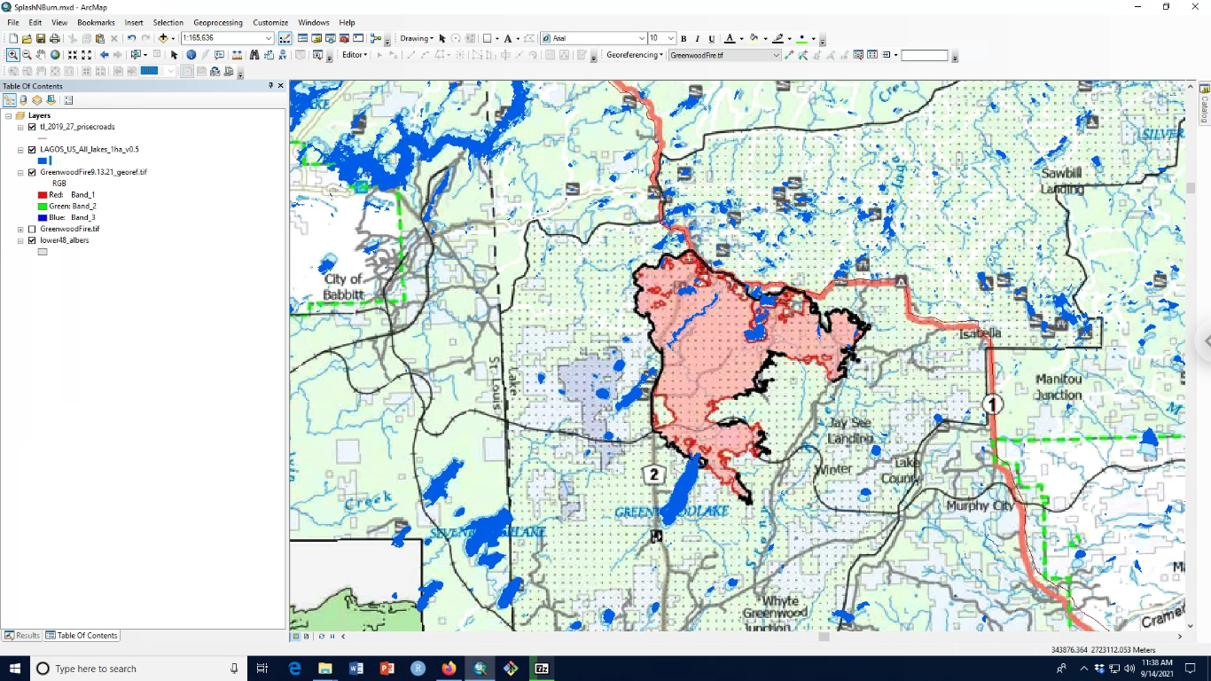
The US Forest Service does publish fire polygons, but not until well after fires are extinguished
So, I manually georeferenced the 9-13-21 fire map to identify potentially impacted lakes/watersheds

Slide 3
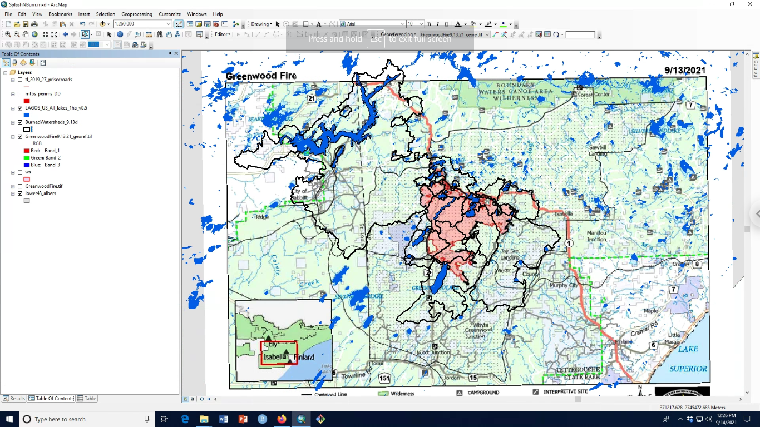
Messy messy! It also appears there were no large wildfires > 200 ha since 1984 in these watersheds

Slide 4
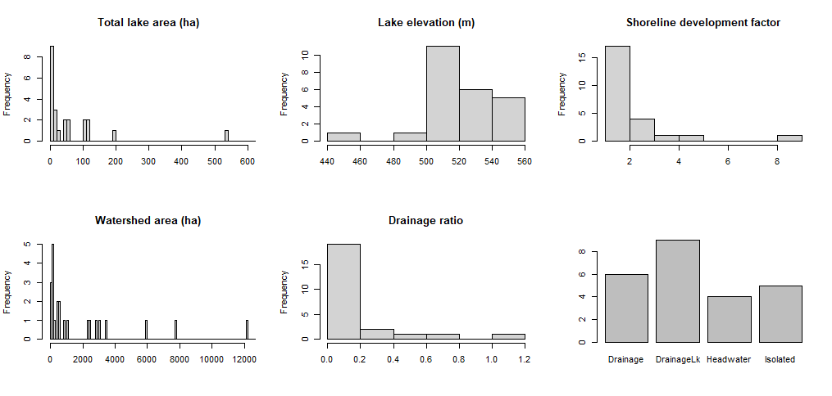
Burned lake characteristics (from LAGOS-US-LOCUS)
One very large 3136 ha lake not shown
One very large 44552 ha ws not shown

Slide 5
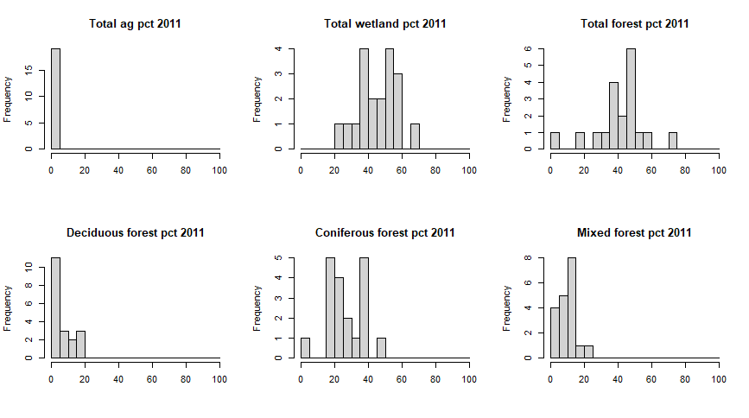
Burned watersheds are mix of wetlands and forest, primarily coniferous (from LAGOSNE)
(19 of 24 lakes > 4ha)

Slide 6
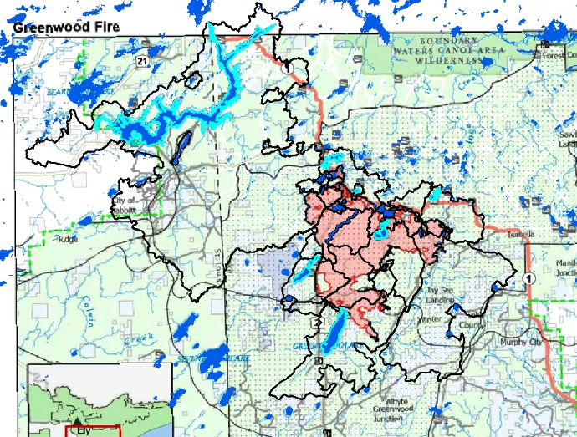
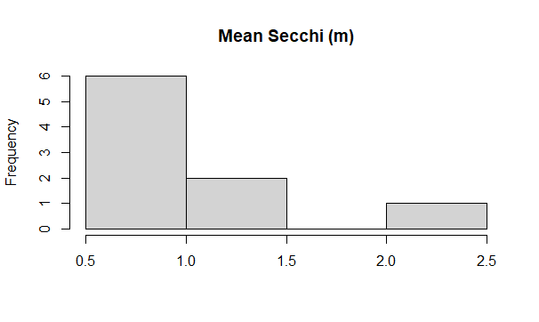
Limno data (LAGOSNE) are limited:
9 lakes, 8 of which only have Secchi (1-35 samples per lake)
8 of which have max depth (LAGOS-US-DEPTH)
Birch Lake accounts for most of the limno data
Highlighted lakes have limno data in LAGOSNE

Slide 7
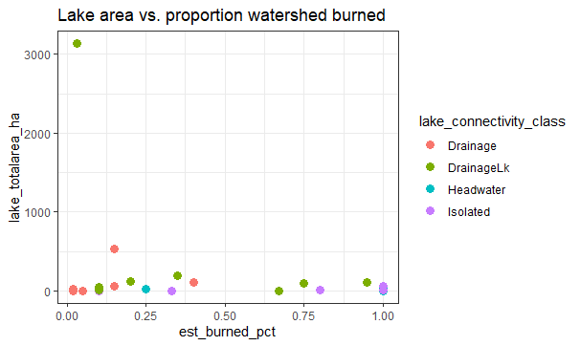
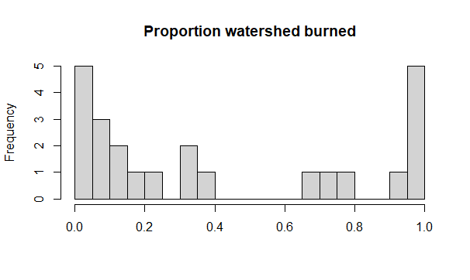
An ecologically important gradient is % watershed burned. I visually estimated this from the 9-13-21 fire map just to give us an idea.
Potentially have low and high subsets?

Slide 8
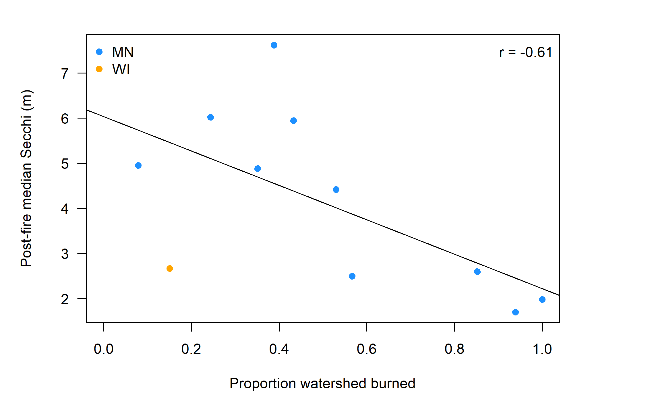
Why the % watershed burned gradient may matter – based on some LAGOSNE data (mostly from 2011 Pagami Creek fire)

Slide 9
Key knowledge gaps
Lake responses along key ecological gradients
Tier 1
Lake: size, depth
Fire: % watershed burned, % high severity, burn pattern
Tier 2
Lake shape, drainage ratio, isolated vs. other lake types
Landscape factors: topography, vegetation, soils, hydrology
Response variables:
Tier 1) Nutrients, chlorophyll-a, Secchi, TSS, DOC
Tier 2) Temperature, ions, mercury, biological community
Lake recoveries following fire
How quickly do lakes return to pre-fire conditions and what lake and landscape factors mediate these recoveries?

